Slide 1

Web-Based Smart Campus Navigation System
and Accessibility Planner
CSA4304 - INTERNET PROGRAMMING
Presented by,
Rajeswari (192311072)
Fathi Muthu Johara M (192411009)
Faculty:
Dr. Jaya Mabel Rani

Slide 2


INTRODUCTION
  Provides a web-based platform for students, faculty, and visitors to easily locate buildings, classrooms, laboratories, and other campus facilities.
  Offers smart route guidance between selected locations using an interactive campus map.
  Supports accessibility-aware navigation by considering ramps, elevators, stairs, and other accessibility facilities when suggesting routes.

Slide 3
MODULES
Module 1: Smart Campus Navigation
Module 2: Accessibility Planning & Management

Slide 4
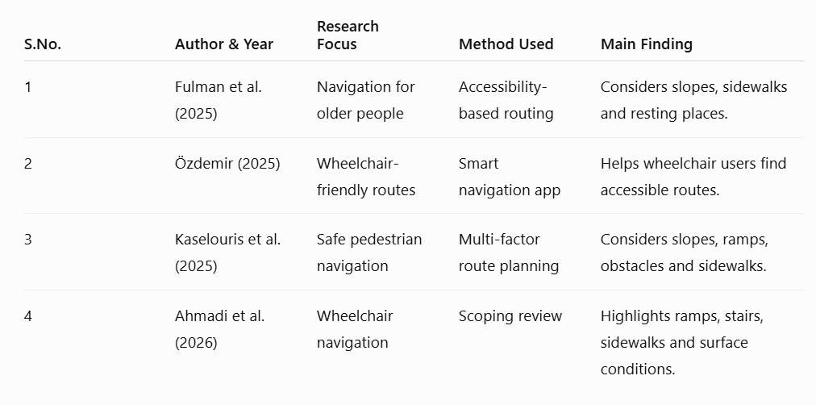
LITERATURE REVIEW

Slide 5
PROBLEM STATEMENT
  Difficulty in navigating large campuses
  Lack of accessibility-aware navigation
  Limited centralized campus information

Slide 6
PROPOSED SYSTEM
  Develop a web-based interactive campus map that allows users to search for buildings, classrooms, laboratories, and other campus facilities.
  Provide smart route planning to calculate suitable paths between the user's current/selected location and destination.
  Include accessibility-aware navigation that considers ramps, elevators, stairs, and blocked pathways to provide suitable routes for different users.

Slide 7
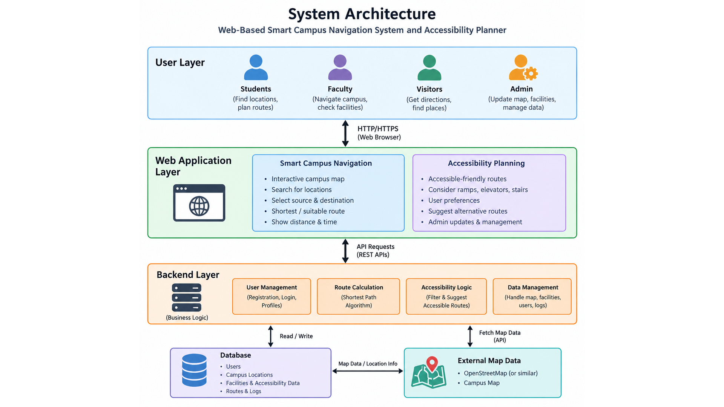
SYSTEM ARCHITECTURE

Slide 8
Module 1: Smart Campus
Navigation
  Interactive campus map with buildings, classrooms, labs, library, cafeteria, etc.
  Search and locate campus facilities.
  Select source and destination.
  Generate the shortest/suitable route.
  Display distance and estimated walking time.

Slide 9
Module 2: Accessibility Planning
& Management
  Provide accessibility-friendly routes.
  Consider ramps, elevators, stairs, and accessible entrances.
  Allow users to select accessibility preferences.
  Admin can update accessibility facilities and blocked pathways.
  Suggest alternative routes when a pathway is unavailable.

Slide 10
.
SDG GOALS
SDG 4 – Quality Education: Easy access to educational facilities.
SDG 10 – Reduced Inequalities: Supports accessible navigation for users with mobility needs.
SDG 11 – Sustainable Cities and Communities: Promotes an inclusive and accessible campus.

Slide 11
IEEE STANDARDS USED
  IEEE/ISO/IEC 23026-2023 – Website Engineering
  IEEE 1012-2024 – Verification and Validation
  IEEE P2998 – Accessible Applications
  IEEE 830 – Software Requirements Specification

Slide 12
APPLICATIONS
  Helps students, faculty and visitors locate campus buildings and facilities.
  Provides routes between classrooms, laboratories, libraries and other locations.
  Supports wheelchair users by identifying accessible routes with ramps and elevators.
  Helps new students and visitors navigate unfamiliar campus areas.
  Allows administrators to update campus maps and accessibility information.

Slide 13
FUTURE SCOPE
Integrate GPS for real-time user location tracking.
Develop a mobile application for easier access.
Use AI to recommend suitable routes based on user preferences.
Add real-time updates for blocked paths and unavailable elevators.
Include voice guidance for visually impaired users.

Slide 14
CONCLUSION
  The proposed system provides a simple and efficient web-based solution for navigating different locations within a college campus.
  It combines smart route planning with accessibility-aware navigation to provide suitable paths for different users.
  The system can improve the campus navigation experience, accessibility, and availability of location information for students, faculty, and visitors.

Slide 15
REFERENCES
  Yang, Y., et al. (2024). Accessibility-Aware Route Planning for Pedestrians with Mobility Impairments. International Journal of Applied Earth Observation and Geoinformation.
  Herskovitz, J., et al. (2023). Accessible Routing and Navigation for People with Mobility Disabilities. ACM Transactions on Accessible Computing.
  OpenStreetMap Foundation. (2024). OpenStreetMap: Open Data for Mapping and Navigation Applications. OpenStreetMap Foundation.
  Agafonov, A., et al. (2023). Indoor and Outdoor Navigation Using Graph-Based Route Planning. International Conference on Information and Communication Technologies.

Slide 16
THANK
YOU!

